Slide 1
Introduction to Cloud Computing Unit 3- Day1 Cloud Architecture
Prashant Kaushal

Slide 2
Recap
Unit 1 -> Computing architecture
Unit 2 ->
Service Model
Deployment Model
Unit 3 ->
Cloud computing architecture and management
Software development for the cloud
Security in cloud
Advanced concepts

Slide 3
Cloud Architecture
• overview of the cloud architecture • insight on the anatomy of the cloud • role of network connectivity in the cloud

Slide 4
Cloud Architecture
Cloud architecture consists of a hierarchical set of components that collectively describe the way the cloud works.
Architecture is the hierarchical view of describing a technology.
includes the components over which the existing technology is built, and
the components that are dependent on the technology.
Anatomy
describes the core structure of the cloud

Slide 5
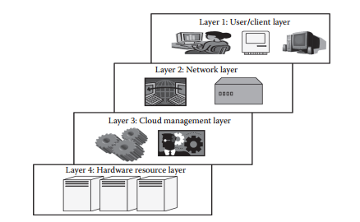
Cloud Architecture

Slide 6
Cloud Architecture
Layer 1 (User/Client Layer)
Layer 2 (Network Layer)
Layer 3 (Cloud Management Layer)
Layer 4 (Hardware Resource Layer)

Slide 7
Layer 1 (User/Client Layer)
Lowest layer
Client/server initiates connection to the cloud.
The client can be any device such as a thin client, thick client, or mobile or any handheld device that would support basic functionalities to access a web application.
Usually, a cloud application can be accessed in the same way as a web application.
But internally, the properties of cloud applications are significantly different.

Slide 8
Layer 2 (Network Layer)
allows the users to connect to the cloud
The whole cloud infrastructure is dependent on this connection where the services are offered to the customers.
This is primarily the Internet in the case of a public cloud.
The public cloud usually exists in a specific location and the user would not know the location as it is abstract.
In the case of a private cloud, the connectivity may be provided by a local area network (LAN).
Usually, when accessing the public or private cloud, the users require minimum bandwidth, which is sometimes defined by the cloud providers.
This layer does not come under the purview of service-level agreements (SLAs), that is, SLAs do not take into account the Internet connection between the user and cloud for quality of service (QoS).

Slide 9
Layer 3 (Cloud Management Layer)
consists of softwares that are used in managing the cloud.
can be a cloud operating system (OS), a software that acts as an interface between the data center (actual resources) and the user, or a management software that allows managing resources.
usually allow resource management (scheduling, provisioning, etc.), optimization (server consolidation, storage workload consolidation), and internal cloud governance.
comes under the purview of SLAs, that is, the operations taking place in this layer would affect the SLAs that are being decided upon between the users and the service providers.

Slide 10
Layer 4 (Hardware Resource Layer)
consists of provisions for actual hardware resources
Usually, in the case of a public cloud, a data center is used in the back end
Similarly, in a private cloud, it can be a data center, or collection of servers.
most important layer that governs the SLAs.
It should be available to the users as quickly as possible and should be within the time that is defined by the SLAs.
the data center consists of a high-speed network connection and a highly efficient algorithm to transfer the data from the data center to the manage
There can be a number of data centers for a cloud, and similarly, a number of clouds can share a data center

Slide 11
Cloud Anatomy
simply defined as the structure of the cloud
cannot be considered the same as cloud architecture
It may not include any dependency on which or over which the technology works whereas architecture wholly defines and describes the technology over which it is working.
Architecture is a hierarchical structural view that defines the technology as well as the technology over which it is dependent or/and the technology that are dependent on it.
Thus, anatomy can be considered as a part of architecture

Slide 12
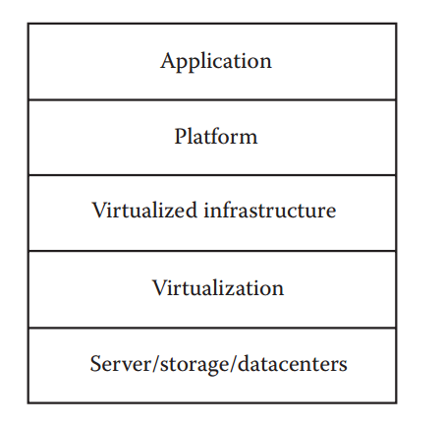
Cloud Anatomy

Slide 13
Cloud Anatomy
1. Application: The upper layer is the application layer. In this layer, any applications are executed. 2. Platform: This component consists of platforms that are responsible for the execution of the application. This platform is between the infrastructure and the application. 3. Infrastructure: The infrastructure consists of resources over which the other components work. This provides computational capability to the user. 4. Virtualization: Virtualization is the process of making logical components of resources over the existing physical resources. The logical components are isolated and independent, which form the infrastructure. 5. Physical hardware: The physical hardware is provided by server and storage units.

Slide 14
Network Connectivity
Cloud computing is a technique of resource sharing where servers, storage, and other computing infrastructure in multiple locations are connected by networks
In the cloud, when an application is submitted for its execution, needy and suitable resources are allocated from this collection of resources;
as these resources are connected via the Internet, the users get their required results.
For many cloud computing applications, network performance will be the key issue to cloud computing performance.

Slide 15
Network Connectivity
Public Cloud Access Networking
Private Cloud Access Networking
Intracloud Networking for Public Cloud Services
Private Intracloud Networking

Slide 16
Public Cloud Access Networking
the connectivity is often through the Internet, though some cloud providers may be able to support virtual private networks (VPNs) for customers.
For security ,connectivity through encrypted tunnels, so that the information may be sent via secure pipes on the Internet.
Since the end-to-end connectivity support is via the Internet, which is a complex federation of interconnected providers (known as Internet service providers [ISPs]), one has to look at the options of selecting the path.

Slide 17
Private Cloud Access Networking
since the cloud is part of an organizational network, the technology and approaches are local to the in-house network structure.
This may include an Internet VPN or VPN service from a network operator.
If the application access was properly done with an organizational network—connectivity in a precloud configuration—transition to private cloud computing will not affect the access performance.

Slide 18
Intracloud Networking for Public Cloud Services
the resources of the cloud provider and thus the cloud service to the customer are based on the resources that are geographically apart from each other but still connected via the Internet
Public cloud computing networks are internal to the service provider and thus not visible to the user/customer; however, the security aspects of connectivity and the access mechanisms of the resources are important.
Another issue to look for is the QoS in the connected resources worldwide. Most of the performance issues and violations from these are addressed in the SLAs commercially.

Slide 19
Private Intracloud Networking
most complicated
it depends on how much intracloud connectivity is associated with the applications being executed in this environment
Private intracloud networking is usually supported over connectivity between the major data center sites owned by the company.
At a minimum, all cloud computing implementations will rely on intracloud networking to link users with the resource to which their application was assigned.
Once the resource linkage is made, the extent to which intracloud networking is used depends on whether the application is componentized based on service-oriented architecture (SOA) or not, among multiple systems.
If the principle of SOA is followed, then traffic may move between components of the application, as well as between the application and the user. The performance of those connections will then impact cloud computing performance overall.
Here too, the impact of cloud computing performance is the differences that exist between the current application and the network relationships with the application.

Slide 20
Path for Internet Traffic
The traditional Internet traffic through a limited set of Internet gateways poses performance and availability issues for end users who are using cloud-based applications.
It can be improved if a more widely distributed Internet gateway infrastructure and connectivity are being supported for accessing applications, as they will provide lower-latency access to their cloud applications.
As the volume of traffic to cloud applications grows, the percentage of the legacy network’s capacity in terms of traffic to regional gateways increases.
Applications such as video conferencing would hog more bandwidth while mission-critical applications such as ERP will consume less bandwidth, and hence, one has to plan a correct connectivity and path between providers and consumers.
CoS / MPLS based internet access
Net neutrality??

Slide 21
Thanks

